Slide 1
Computer Algorithms
Segment 5
Graphs basic & Traversal Techniques

Slide 2
Terminology
A graph is a collection of nodes, called vertices, and a collection of line segments, called lines, edges, or arcs, connecting pairs of vertices.
In other words, a graph consists of 2 sets:
  A set of lines
  A set of vertices

Slide 3
Terminology
Graphs may be either directed or undirected.
An undirected graph is a graph in which there is no direction associated with the lines.
In an undirected graph, the flow between two vertices can go in either direction.

Slide 4
Terminology
A directed graph or digraph is a graph in which each line has a direction associated with it.
In a directed graph, the flow along an edge between 2 vertices can only follow the indicated direction.

Slide 5
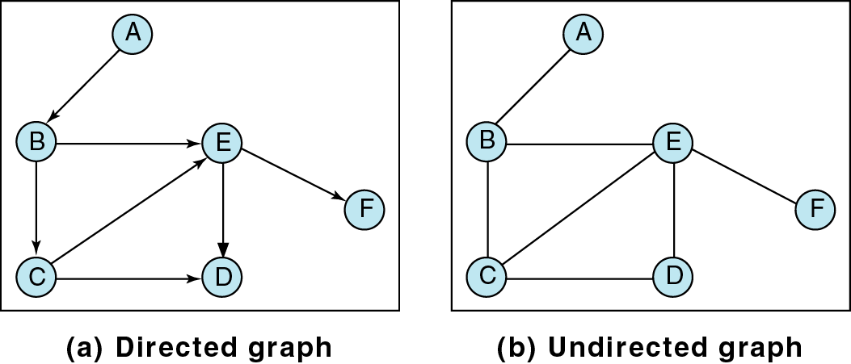
Terminology

Slide 6
Terminology
2 vertices in a graph are said to be adjacent (or neighbors) if an edge directly connects them.
A and B are adjacent
D and F are not adjacent

Slide 7
Terminology
A path is a sequence of vertices in which each vertex is adjacent to the next one.
A,B,C,E is a path
A,B,E,F is a path
A,B,E,C is NOT a path
because, although E
is adjacent to C,
C is not adjacent
to E (note direction).

Slide 8
Terminology
Note that both directed and undirected graphs have paths.
In an undirected graph, you may travel in either direction.
In a directed graph, you may only travel along the given direction of the arcs.

Slide 9
Terminology
A cycle is a path that starts and ends with the same vertex.
Note: a single vertex is not a cycle.
B, C, D, E, B is a
cycle in the the
undirected graph
but not in the
directed graph.

Slide 10
Terminology
A self edge or loop is an arc that begins and ends at the same vertex.
A

Slide 11
Terminology
Two vertices are said to be connected if there is a path between them.
A graph is said to be connected if, suppressing direction, there is a path from each vertex to every other vertex.
Furthermore, a directed graph is strongly connected if there is a path from each vertex to every other vertex.

Slide 12
Terminology
A directed graph is weakly connected if at least 2 vertices are not connected.
A graph is disconnected or disjoint if it is not connected.

Slide 13
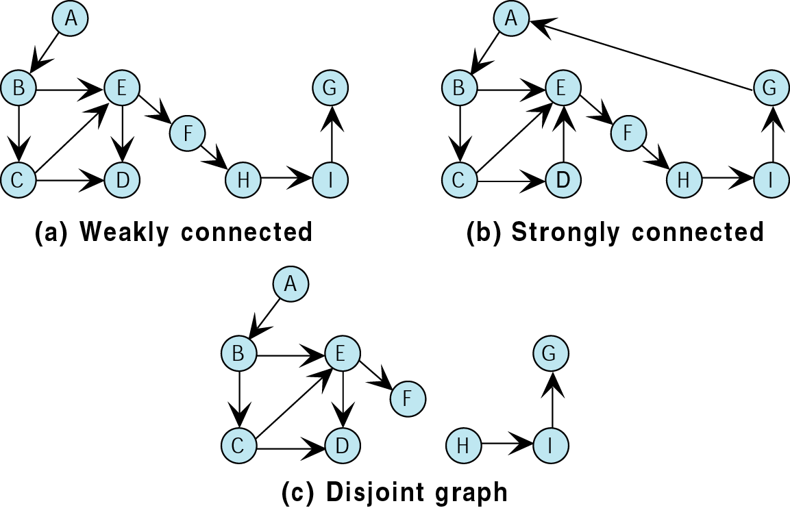
Terminology

Slide 14
Terminology
The degree of a vertex is the number of edges incident to it.
The outdegree of a vertex in a digraph is the number of arcs leaving the vertex.
The indegree of a vertex in a digraph is the number of arcs entering the vertex.

Slide 15
Terminology
The degree of vertex B is …
The outdegree of vertex B is …
The indegree of vertex B is …
3
2
1

Slide 16
Traverse Graph
Because a vertex in a graph can have multiple parents, the traversal of a graph presents some problems not found in the traversal of linear lists and trees.
Specifically, we must ensure that we process the data in each vertex once and only once.

Slide 17
Traverse Graph
Because there are multiple paths to a vertex, we may arrive at it from more than one direction as we traverse the graph.
The traditional solution to this problem is to include a ‘visited’ flag at each vertex.
Before the traversal, we set the visited flag in each vertex to ‘off.’
Then, as we traverse the graph, we set the visited flag to ‘on’ to indicate that the data in a given vertex has been processed.

Slide 18
Traverse Graph
Note that a graph traversal algorithm is slightly different from a “print all vertices” algorithm.
A graph-traversal algorithm will only visit all the nodes that it can reach.
In other words, a graph traversal that starts at vertex V will visit all vertices W for which there exists a path between V and W.

Slide 19
Traverse Graph
Hence, unlike a tree traversal which always visits all of the nodes in a tree, a graph traversal does not necessarily visit all of the vertices in the graph (unless the graph is connected).
If the graph is not connected, a graph traversal that begins at vertex V will visit only a subset of the graph’s vertices.
This subset is called the connected component containing V.

Slide 20
Traverse Graph
There are 2 standard graph traversals:
  Depth first
  Breadth first
Both of these methods use the ‘visited’ flag.

Slide 21
Depth-First Traversal
In the depth-first traversal, we process all of a vertex’s descendants before we move to an adjacent vertex.
This concept is most easily seen when the graph is a tree.

Slide 22
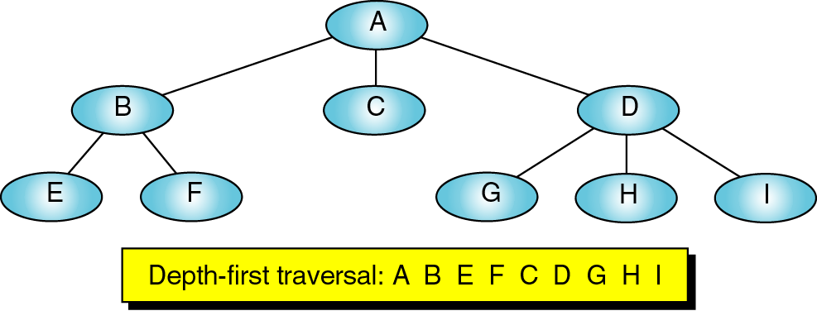
Depth-First Traversal
Here we show the preorder traversal, one of the standard depth-first traversals.

Slide 23
Depth-First Traversal
In a similar manner, the depth-first traversal of a graph starts by processing the first vertex of the graph.
After processing the first vertex, we select any vertex adjacent to the first vertex and process it.
As we process each vertex, we select an adjacent vertex until we reach a vertex with no adjacent entries.
This is similar to reaching a leaf in a tree.

Slide 24
Depth-First Traversal
We then back out of the structure, processing adjacent vertices as we go.
It should be obvious that this logic requires a stack (or recursion) to complete the traversal.
The order in which the adjacent vertices are processed depends on how the graph is physically stored.

Slide 25
Depth-First Traversal
On the next slide we’ll walk through a depth-first traversal.
The number in the box next to a vertex indicates the processing order.
The stacks below the graph show the stack contents as we work our way down the graph and then as we back out.

Slide 26
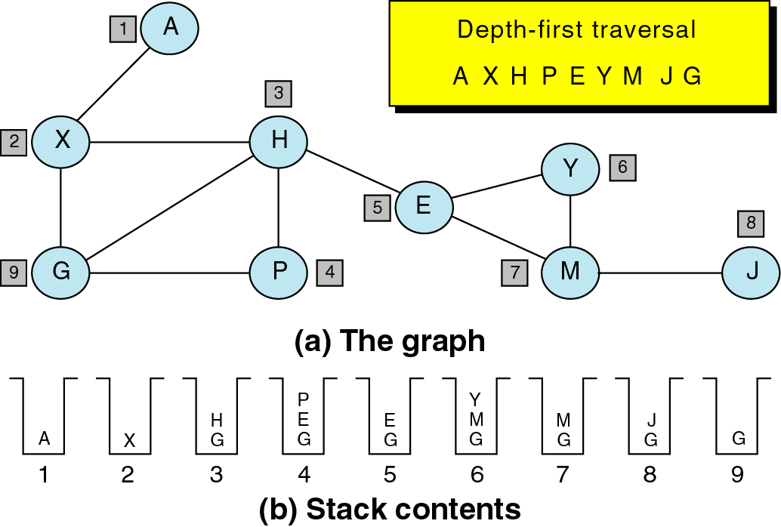
Depth-First Traversal
1. We begin by
pushing the 1st vertex,
A, onto the stack.

Slide 27
Depth-First Traversal
2. We then loop, pop
the stack, and, after
processing the vertex, push all of its adjacent vertices onto the stack. To process X at Step 2, therefore, we pop X from the stack, process it, and
then push G and H
onto the stack.

Slide 28
Depth-First Traversal
3. When the stack is
empty, the traversal
is complete.

Slide 29
Breadth-First Traversal
In the breadth-first traversal of a graph, we process all adjacent vertices of a vertex before going to the next level.
We also saw the breadth-first traversal of a tree.

Slide 30
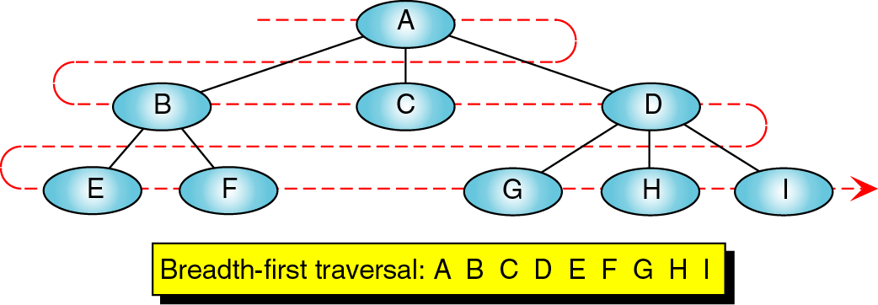
Breadth-First Traversal
Here we see that the breadth-first traversal starts at level 0 and then processes all the vertices in level 1 before going on to process the vertices in level 2.

Slide 31
Breadth-First Traversal
The breadth-first traversal of a graph follows the same approach as the BFT of a tree.
We begin by picking a starting vertex.
After processing it, we process all of its adjacent vertices.
After we process all of the first vertex’s adjacent vertices, we pick the first adjacent vertex and process all of its adjacent vertices, then the 2nd adjacent vertex and process all of its adjacent vertices, etc.

Slide 32
Breadth-First Traversal
The breadth-first traversal uses a queue rather than a stack.
As we process each vertex, we place all of its adjacent vertices in a queue.
Then, to select the next vertex to be processed, we remove a vertex from the queue and process it.

Slide 33
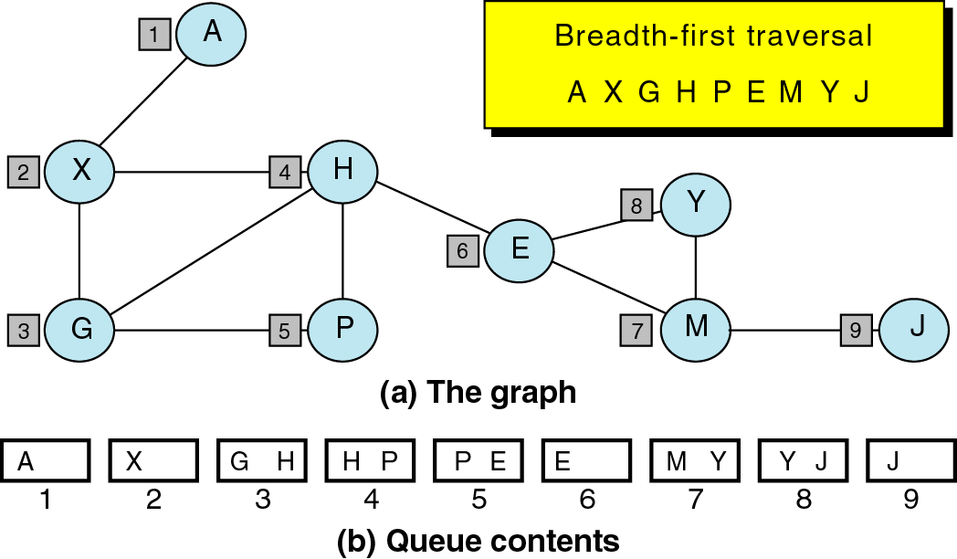
Breadth-First Traversal
1. We begin by
enqueuing the 1st
vertex, A.

Slide 34
Breadth-First Traversal
2. We then loop,
dequeuing the queue,
and, after processing
the vertex at the front
of the queue, enqueue
all of its adjacent
vertices. To process X
at Step 2, therefore,
we dequeue X, process
it, and then enqueue
G and H.

Slide 35
Breadth-First Traversal
3. When the queue is
empty, the traversal
is complete.

Slide 36
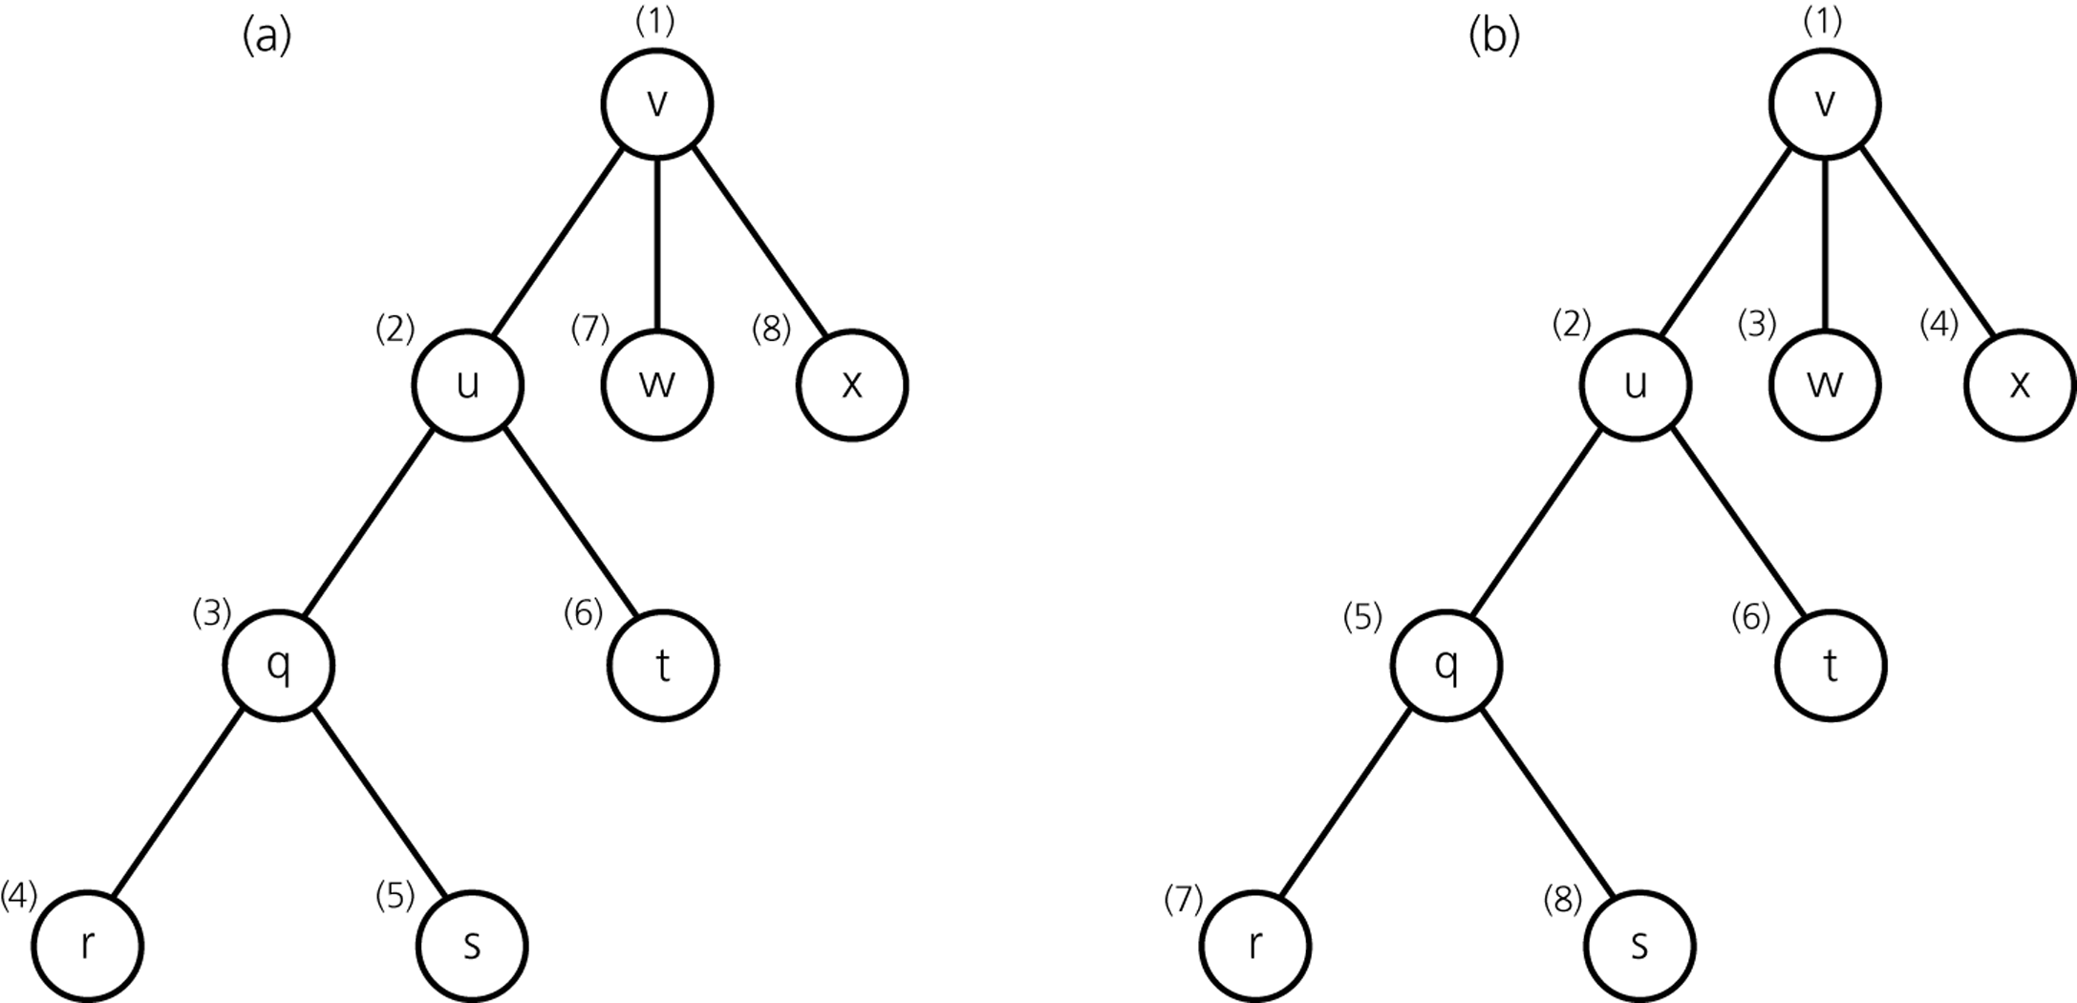
Traversals Example
Visitation order
for a DFS and a
BFS.
(a) Depth-first search (b) Breadth-first search

Slide 37
Graph Storage Structures
To represent a graph, we need to store two sets:
  The first set represents the vertices of the graph.
  The second set represents the edges of the graph.
The most common structures used to store these sets are arrays and linked lists.
Although the arrays offer some programming and processing efficiencies, to use them, the number of vertices must be known in advance – a major limitation.

Slide 38
Adjacency Matrix
The adjacency matrix uses a vector (1-dimensional array) to store the vertices and a matrix (2-dimensional array) to store the edges.
If 2 vertices are adjacent – that is, if there is an edge between them, the matrix intersect has a value of 1.
If there is no edge between them, the intersect is set to 0.

Slide 39
Adjacency Matrix
If the graph is directed, then the intersection chosen in the adjacency matrix indicates the direction.

Slide 40
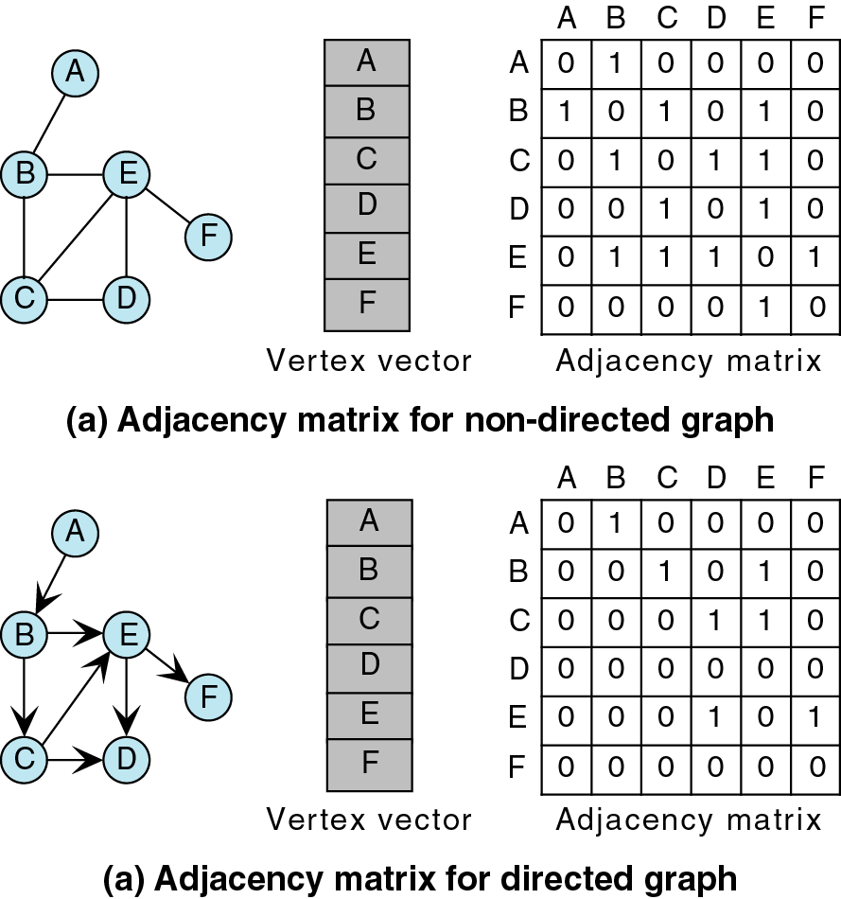
Adjacency Matrix
Here we see the vertex vectors
and the adjacency matrices
for the graphs shown.
The vertex vector contains an
entry for each node in the
graph.
The adjacency matrix contains
a ‘1’ at the appropriate
intersection to represent an
edge.

Slide 41
Adjacency Matrix
For example, A and B are
adjacent in the graph in (a).
Hence, at the intersection
of A and B in the adjacency
matrix, we place a ‘1’ to
denote an edge.
Similarly, for the digraph
shown, we place a ‘1’ at the
intersection of A and B.
However, because this is a
digraph, there is only one ‘1’.

Slide 42
Adjacency Matrix
The intersection at which the
‘1’ appears is determined by
the direction of the arc
between adjacent nodes of
the digraph.
It doesn’t matter which
intersection gets the ‘1’ – just
remain consistent.
I like the notation:
matrix[i][j] = 1 if there is an
edge from vertex i to vertex j

Slide 43
Adjacency Matrix
In addition to the limitation that the size of the graph must be known before the program starts, there is another serious limitation in the adjacency matrix: only 1 edge can be stored between any 2 vertices.
This can be an issue in modeling some structures (e.g., 2 different flights between the same cities).

Slide 44
Adjacency List
If the graph structure is unknown ahead of time, we can use linked lists to implement the vertex vector and adjacency matrix.
In this case, they are referred to as a vertex list and an adjacency list.

Slide 45
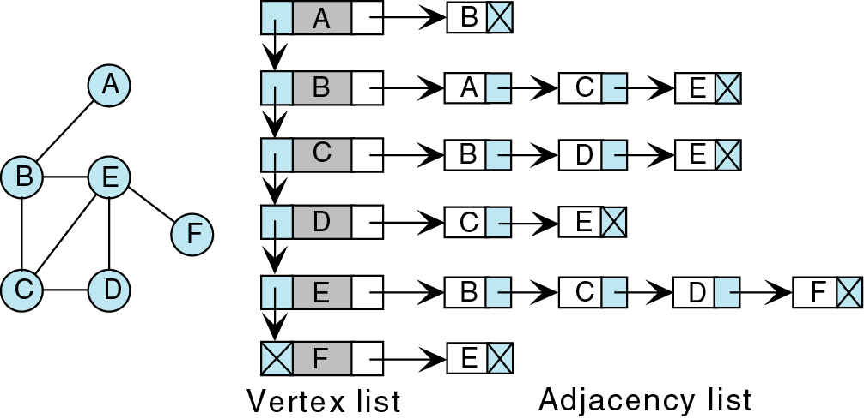
Adjacency List
Here, we have a linked list of the nodes in the graph. Each node
in the graph contains a pointer to the head of an adjacency list.
The adjacency list is a linked list containing adjacent nodes.

Slide 46
Graph Structure
Now we will present a possible implementation of the graph data structure along with some of the basic graph operations.

Slide 47
Queues
Like a stack, special kind of linear list
One end is called front
Other end is called rear
Additions (insertions or enqueue) are done at the rear only
Removals (deletions or dequeue) are made from the front only

Slide 48







Bus Stop Queue
Bus Stop
front
rear
rea
rear
rear
rear
Remove a person from the queue

Slide 49
Bus Stop Queue
Bus Stop
front
rear
rear
rear

Slide 50
Bus Stop Queue
Bus Stop
front
rear
rear

Slide 51

Bus Stop Queue
Bus Stop
front
rear
rear
Add a person to the queue
A queue is a FIFO (First-In, First-Out) list.

Slide 52
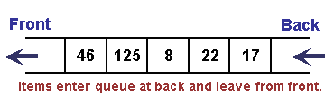
What is a queue?
A queue system is a linear list in which deletions can take place only at one end the “front” of the list, and the insertions can take place only at the other end of the list, the “back” . Is called a First-In-First-Out(FIFO)

Slide 53
Enqueue Pseudocode
This procedure insert an element Item into a queue
Enqueue(Q, N, Front, Rear, Item)
{
if Front=1 and Rear=N, or if Front=Rear+1, then // Q already filled
overflow, and return
if Front = Null then // Find the new value of Rear
Front = 1 and Rear = 1 //Queue initially empty
else if Rear = N then
Rear = 1
else
Rear = Rear + 1
Q[Rear] = Item // Insert new element
Return
}
Reference: Data Structure- Schaum’s, page 192

Slide 54
Dqueue Pseudocode
This procedure deletes an element from a queue and assigns it to the variable Item
Dqueue(Q, N, Front, Rear, Item)
{
if Front = Null then // Q already empty
Underflow, and Return
Item = Q[Front]
if Front= Rear then // Find the new value of Front
Front = Null and Rear = Null
else if Front = N then
Front = 1
else
Front = Front + 1
Return
}
Reference: Data Structure- Schaum’s, page 192

Slide 55
Depth-First Traversal
Recall that the DFT visits all of the vertices in a graph by processing an adjacent vertex and all of its descendents before processing another adjacent vertex.
Also recall that we could implement the algorithm in 2 ways: recursion or a stack.
Here, we will use a stack.

Slide 56
Depth-First Traversal
When we reach a vertex, we push its address onto the stack.
Then, we pop the stack, process the vertex, and push all of its adjacent vertices onto the stack.
The problem is that a vertex may be reached by more than one path through the graph.
Consequently, we must ensure that each vertex is processed once and only once.

Slide 57
Depth-First Traversal
To do this, we use the ‘processed’ or ‘visited’ field.
When we begin the traversal, we set the processed flags to 0.
When we push a vertex onto the stack, we set its processed field to 1 – indicating that it is in the stack awaiting its turn. This prevents us from pushing it more than once.

Slide 58
Depth-First Traversal
Finally, when we process the vertex, we set its flag to 2.
Now, if we arrive at a vertex more than once, we will know that we have already pushed it onto the stack or even processed it and won’t push it a second time.

Slide 59
Depth-First Traversal Pseudocode
DFS(G)
{
for each vertex u ϵ V[G]
{
do color[u] ← WHITE
π[u] ← NIL
}
time ← 0
for each vertex u ϵ V[G]
{
do if color[u] ← WHITE then
DFS-Visit(u)
}
}

Slide 60
Depth-First Traversal Pseudocode (cont)
DFS-Visit(u)
{
color(u) ← GRAY
time ← time +1
d[u] ← time
for each v ϵ Adj[u]
{
do if color [v] = WHITE then
{ π[v] ← u
DFS-Visit(v) }
}
color [u] ← BLACK
f[u] ← time
time ← time+1
} //Reference: Introduction to algorithm-CORMEN, page 541
The running time of DFS is Ө(V+E).

Slide 61
Breadth-First Traversal
Recall that the BFT processes a vertex and then processes all of its adjacent vertices.
Whereas we used a stack for the DFT, we use a queue for the BFT.

Slide 62
Breadth-First Traversal Pseudocode
BFS(G,s)
for each vertex u ϵ V[G]-{s}
{
do color[u] ← WHITE
{
d[u] ← ∞
π[u] ← NIL
}
}
colors[s] ← GRAY
d[s] ← 0
π[s] ← NIL
Q ← Ø
Enqueue(Q,s)
Given a graph G=(V,E) is represented using adjacency lists, the color of each vertex uϵV is stored in the variable color[u], predecessor of u is in π[u], the distance from s to u is in d[u]

Slide 63
Breadth-First Traversal Pseudocode (cont)
The operations of enqueuing and dqueuing take O(1) time, so total time for queue operations is O(V). Total time spent in scanning adjacency lists is O(E).The overhead for initialization is O(V) and thus the total running time of BFS is O(V+E).
while Q ≠ Ø
{
do u ← Dqueue (Q)
{
for each v ϵ Adj[u]
{
do if color [v] = WHITE{
then color [v] ← GRAY
[v] ← d[u] +1
π[v] ← u
Enqueue (Q, v)}}
color [u] ← BLACK
}
} // //Reference: Introduction to algorithm-CORMEN, page 532

Slide 64
TREE
A tree is an undirected graph which is connected and acyclic. It is easy to show that if graph G
  G (V,E) is connected.
  G (V,E) is acyclic.
  |E| =|V| -1

Slide 65


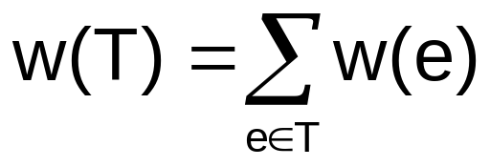
Spanning Trees
A spanning tree in an undirected graph G(V,E) is a subset of edges that are acyclic and connect all the vertices in V.
It follows from the above conditions that a spanning tree must consist of exactly n-1 edges.
Now suppose that each edge has a weight associated with it: Say that the weight of a tree T is the sum of the weights of its edges;

Slide 66
Example: Spanning Tree
1
28
1
28
1
28
10
2
10
2
2
14
16
14
16
14
16
6
6
6
7
3
7
3
7
3
24
24
25
24
5
18
5
18
5
12
22
22
4
4
4
connected graph
spanning tree
cost = 110
spanning tree
cost = 129

Slide 67
Minimum Spanning Tree
A spanning tree is a tree that contains all of the vertices in the graph and enough of its edges to form a tree.
The minimum spanning tree of a network is a spanning tree in which the sum of its edge weights is guaranteed to be minimal.
It is possible to have more than one minimum spanning tree – however the weights of the different MSTs will be the same.
The minimum spanning tree in a weighted graph G(V,E) is one which has the smallest weight among all spanning trees in G(V,E).

Slide 68
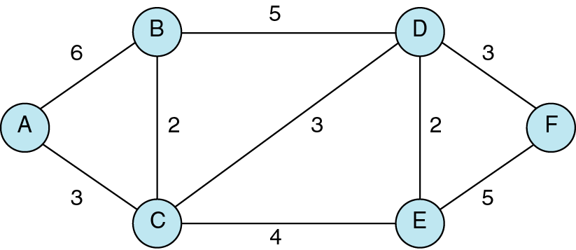
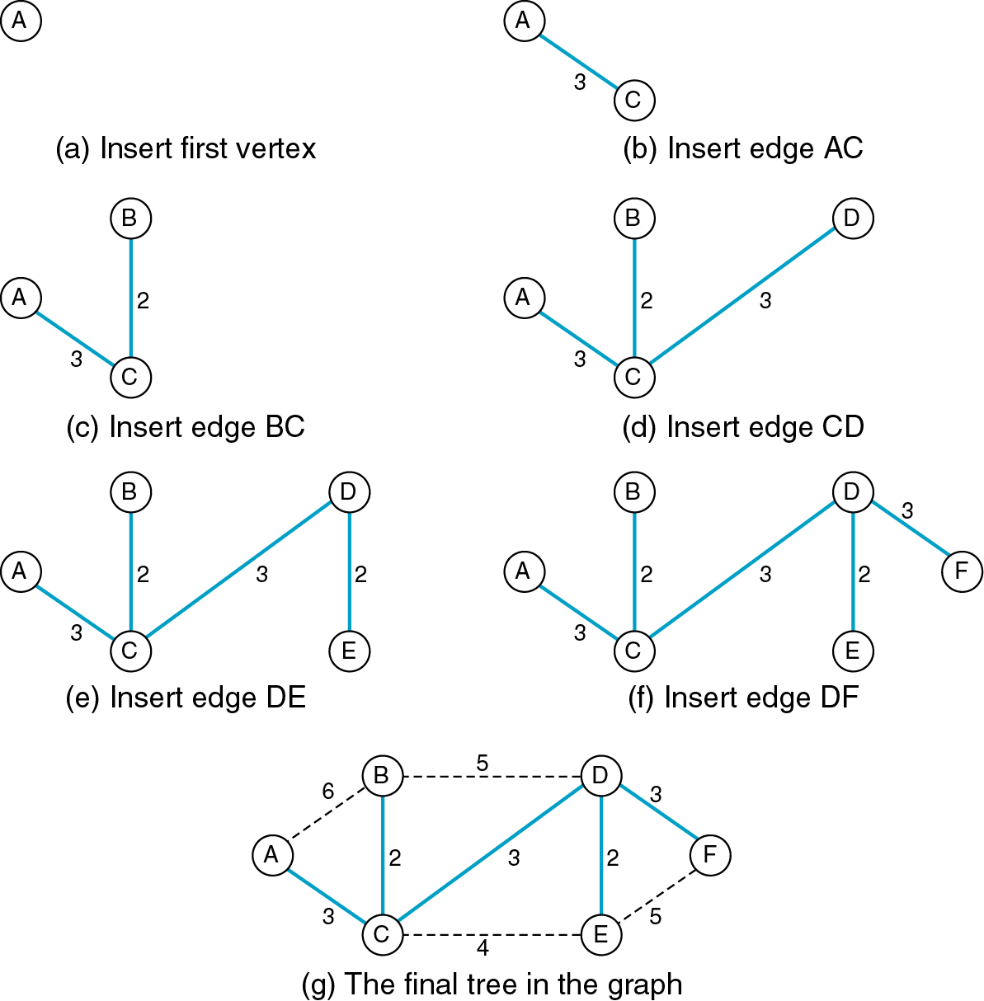
Minimum Spanning Tree
The bottom graph is a
spanning tree of the top
graph.
Note that every node from
the top graph is represented
in the spanning tree.
The bottom graph also
happens to be the
minimum spanning tree.

Slide 69
Minimum Spanning Tree
There are many applications for minimum spanning trees, all with the requirement to minimize some aspect of the graph, such as the distance among all the vertices in the graph.
For example, given a network of computers, we could create a graph that connects all of the computers.
The MST gives us the shortest length of cable that can be used to connect all of the computers while ensuring that there is a path between any two computers.

Slide 70
Minimum Spanning Tree
Before we develop a formal algorithm to determine the MST of a graph, we will manually determine the MST of an example graph.

Slide 71
Minimum Spanning Tree
We can start with any vertex, so we’ll just start with A.
Then, we add the vertex that gives the minimum-weighted edge with A.
Our options are AB or AC – we choose AC because 3 is less than 6
MST

Slide 72
Minimum Spanning Tree
Now, we have vertices A and C in our MST.
From these 2, we choose the edge with the minimum weight that connects a vertex in our MST to a vertex not already included in our MST.
MST

Slide 73
Minimum Spanning Tree
Our options are
  CB, weight = 2
  CD, weight = 3
  CE, weight = 4
  AB, weight = 6
We choose CB because it has the minimum weight.
MST

Slide 74
Minimum Spanning Tree
Now we continue with the same process – here are our choices:
  BD, weight = 5
  CD, weight = 3
  CE, weight = 4
We choose CD because it has the minimum weight.
MST

Slide 75
Minimum Spanning Tree
Now we continue with the same process – here are our choices:
  CE, weight = 4
  DE, weight = 2
  DF, weight = 3
We choose DE because it has the minimum weight.
MST

Slide 76
Minimum Spanning Tree
Now we are down to our last node. Our choices are:
  EF, weight = 5
  DF, weight = 3
We choose DF because it has the minimum weight.
MST

Slide 77
Minimum Spanning Tree
Here is our final MST.

Slide 78
Minimum Spanning Tree
The algorithm just described is Prim’s algorithm.
Prim’s algorithm finds a minimum spanning tree that begins at any vertex.
Hence, the MST produced by Prim’s algorithm may vary depending on which vertex you start at.

Slide 79
Prim’s Algorithm
A greedy method to obtain a minimum-cost spanning tree builds this tree edge by edge.
The algorithm will start with a tree that includes only a minimum-cost edge of graph G.
Then, edges are added to this tree one by one.
The next edge (i,j) to be added is such that i is a vertex already added in the tree, j is a vertex not yet included, and the cost of (i,j), cost[i,j], is minimum among all edges (k,l) such that vertex k is in the tree and vertex l is not in the tree.
To determine this edge (i,j) efficiently, we associate with each vertex j not yet included in the tree a value near[j]
The value near[j] is a vertex in the tree such that cost[j, near[j]] is minimum among all choices for near[j].

Slide 80
Prim’s Algorithm (cont.)
We define near[j]=0 for all vertices j that are already in the tree.
The next edge to include is defined by the vertex j such that near[j] ≠ 0 (j not already in the tree) and cost[j, near[j]] is minimum.

Slide 81
Prim’s Algorithm Pseudocode
Algorithm Prim(E, cost, n, t)
// E is the set of edges in G. cost[1:n, 1:n] is the cost adjacency matrix of
// an n vertex graph such that cost[i,j] is either a positive real number or
// ∞ if no edge (i,j) exists. A minimum spanning tree is computed and
// stored as a set of edges in the array t[1:n-1,1:2]. (t[i,1],t[i,2]) is an
// edge in the minimum-cost spanning tree.
//The final cost is returned.
{
Let (k,l) be an edge of minimum cost in E;
mincost := cost[k,l];
t[1,1] :=k; t[1,2] :=l;
for i:=1 to n do // Initialized near
if (cost[i,l] < cost[i,k]) then near[i] :=l;
else near[i] :=k;
near[k] :=near[l] :=0;

Slide 82
Prim’s Algorithm Pseudocode (cont.)
for i:=2 to n-1 do
{// Find n-2 additional edges for t
Let j be an index such that near[j] ≠0 and
cost[ j, near[j]] is minimum;
t[i,1] :=j; t[i,2] := near[j];
mincost := mincost+cost[j, near[j]];
near[j] :=0;
for k:=1 to n do // Update near[ ].
if ((near[k] ≠0) and (cost[k, near[k]] > cost[k,j]) ) then
near[k] :=j;
}
return mincost;
} //Reference: Computer algorithm-SAHNI, page 221

Slide 83
Prim’s Algorithm (complexity)
2
The time required by algorithm Prim is O(n ), where n is the number of vertex in the graph G. To see this, note that line 9 takes O(|E|) time and line 10 takes Ө(1) time. The for loop of line 12 takes Ө(n) time. Lines 18 and 19 and for loop of line 23 require O(n) time. So, each iteration of the for loop of line 16 takes O(n) time. The total time for the for loop of line 16 is therefore O(n ). Hence, Prim runs in O(n ) time.
2
2

Slide 84
Kruskal’s Algorithm
1
28
1
1
10
2
10
2
10
2
14
16
6
6
6
7
3
3
7
3
24
7
25
5
18
5
5
12
12
22
4
4
4
a
b
c

Slide 85
Kruskal’s Algorithm (cont.)
1
1
1
10
2
10
2
10
2
14
14
16
14
16
6
6
6
7
3
7
3
7
3
5
12
5
12
5
12
22
4
4
4
d
e
f

Slide 86
Kruskal’s Algorithm Pseudocode
Algorithm Kruskal(E, cost, n, t)
// E is the set of edges in G. G has n vertices. cost[u,v] is the cost of
// edge (u,v). t is the set of edges in the minimum-cost spanning tree.
// The final cost is returned.
{
Construct a heap out of the edges using Heapify;
for i:=1 to n do parent [i] := -1;
// Each vertex is in a different set.
i:= 0; mincost := 0.0;
while((i < n-1) and (heap not empty)) do
{
Delete a minimum cost edge (u,v) from the heap
and reheapify.
j := Find(u); k:=Find(v);

Slide 87
Kruskal’s Algorithm Pseudocode (cont.)
if ( j ≠ k) then
{
i:=i+1;
t[i,1] :=u; t[i,2] := v;
mincost := mincost+cost[u, v];
Union (j,k);
}
}
if (i ≠ n-1) then write (“No spanning tree”);
else return mincost;
}
Reference: Computer algorithm-SAHNI, page 224
Complexity is
O(|E|log|E|)

